Slide 1
ANN
Architecture of ANN

Slide 2
Architecture of NN
Neural nets are often classified as single layer or multilayer. In determining the number of layers, the input units are not counted as a layer, because they perform no computation. Equivalently, the number of layers in the net can be defined to be the number of layers of weighted interconnects links between the slabs of neurons. The net shown below has two layers of weights:

Slide 3
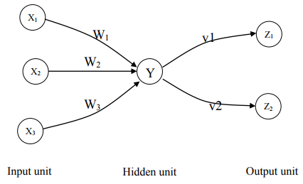
simple neural network

Slide 4
single neural network
A single-layer net has one layer of connection weight. Often, the units can be distinguished as input units, which receive signals from the outside world, and output units, from which the response of the net can be read. In the typical single-layer net shown in figure bellow the input units are fully connected to output units but are not connected to other input units and the output units are not connected to other output units.

Slide 5
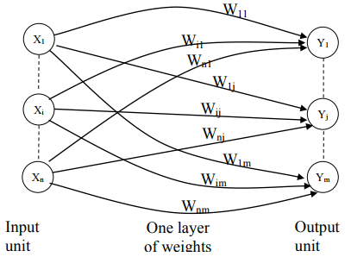
Single-layer neural network

Slide 6
Multilayer Neural Net
A Multilayer net is a net with one or more layers (or levels) of nodes which is called hidden units, between the input units and the output units. Typically, there is a layer of weights between two adjacent levels of units (input, hidden, or output). Multilayer nets can solve more complicated problems than can single-layer nets, but training may be more difficult. However, in some cases, training may be more successful because it is possible to solve a problem that a single-layer net cannot be trained to perform correctly at all. The figure bellow shows the multilayer neural net.

Slide 7
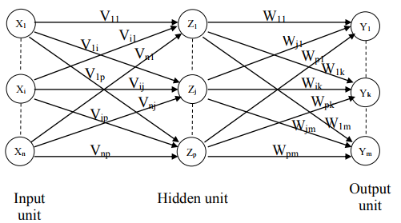
Multilayer Neural Net

